Slide 1
Image Captioning bot
Made By ~
Aman Bahuguna (18BCS2441)
Deepak Yadav (18BCS2446)
Gyan Ranjan Kumar (18BCS2431)

Slide 2
TABLE OF CONTENT
Project Description
Datasets
Models: RNN + CNN
Architecture details
Evaluation problems
Results

Slide 3
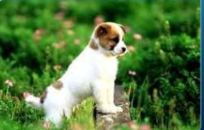
Introduction
What do you See in the Picture?
Well some of you might say “A white dog in a grassy area”, some may say “White dog with brown spots” and yet some others might say “A dog on grass and some pink flowers”.

Slide 4
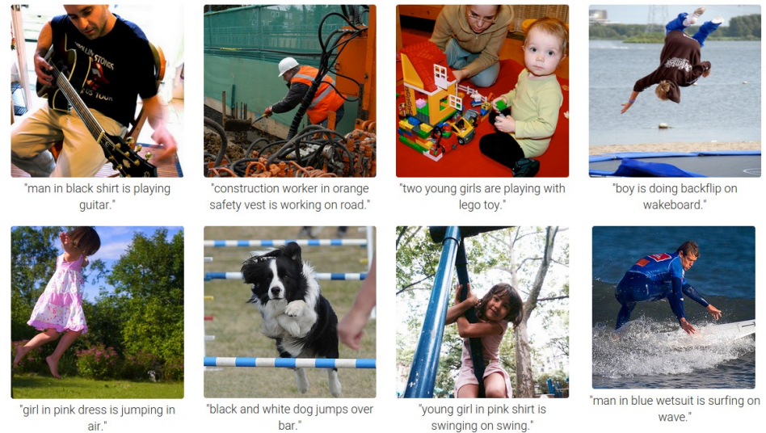
But, can you write a computer program that takes an image as input and produces a relevant caption as output?

Slide 5
Application of Image Captioning
Probably can be used in the applications where text is used mostly and with the use of this we can infer a image in form of text.
NLP is used extensively in the market now-a-days. For example, summarizing or gaining insights from a large corpus of text. In the same way, we can use the same concept to get insights from images as well.
We can build a 360-degree metastore and make use of it in a wide variety of business like making user searches more efficient on an e-commerce platform based on metadata of products, other may be some other things like recommendations and all.
We can describe like what happen in a given video segment.
Can be used to give something back to mankind for visually impaired people. and many more.

Slide 6
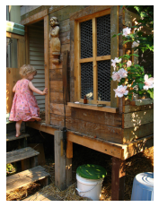
Datasets
Flickr8k
8000 images, each annotated with 5 sentences via AMT
Training Set — 6000 images
Dev Set — 1000 images
Test Set — 1000 images
A child in a pink dress is climbing up a set of stairs in an entry way
A girl going into a wooden building .
A little girl climbing into a wooden playhouse .
A little girl climbing the stairs to her playhouse .
A little girl in a pink dress going into a wooden cabin .

Slide 7

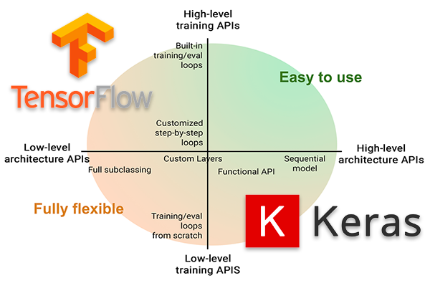
Keras is an open-source software library that provides a Python interface for artificial neural networks. Keras acts as an interface for the TensorFlow library.

Slide 8
Models: RNN + CNN
How to combine image and and sentence
RNN + CNN:
Encoder-decoder model
Multimodal layer

Slide 9
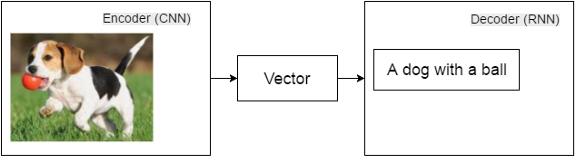
Encoder-decoder model: image caption

Slide 10
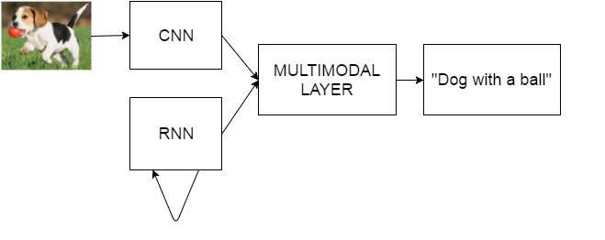
Multimodal Layer

Slide 11
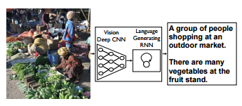
Encoder-decoder model:

Slide 12
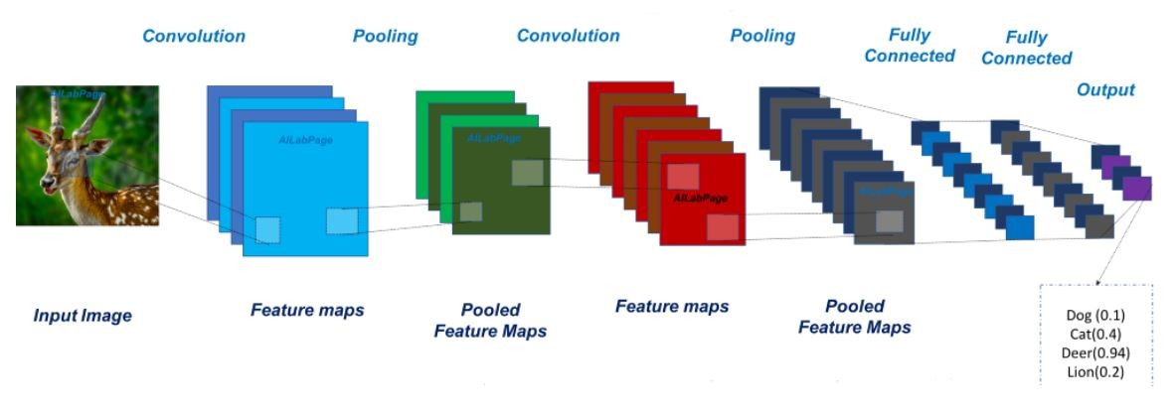
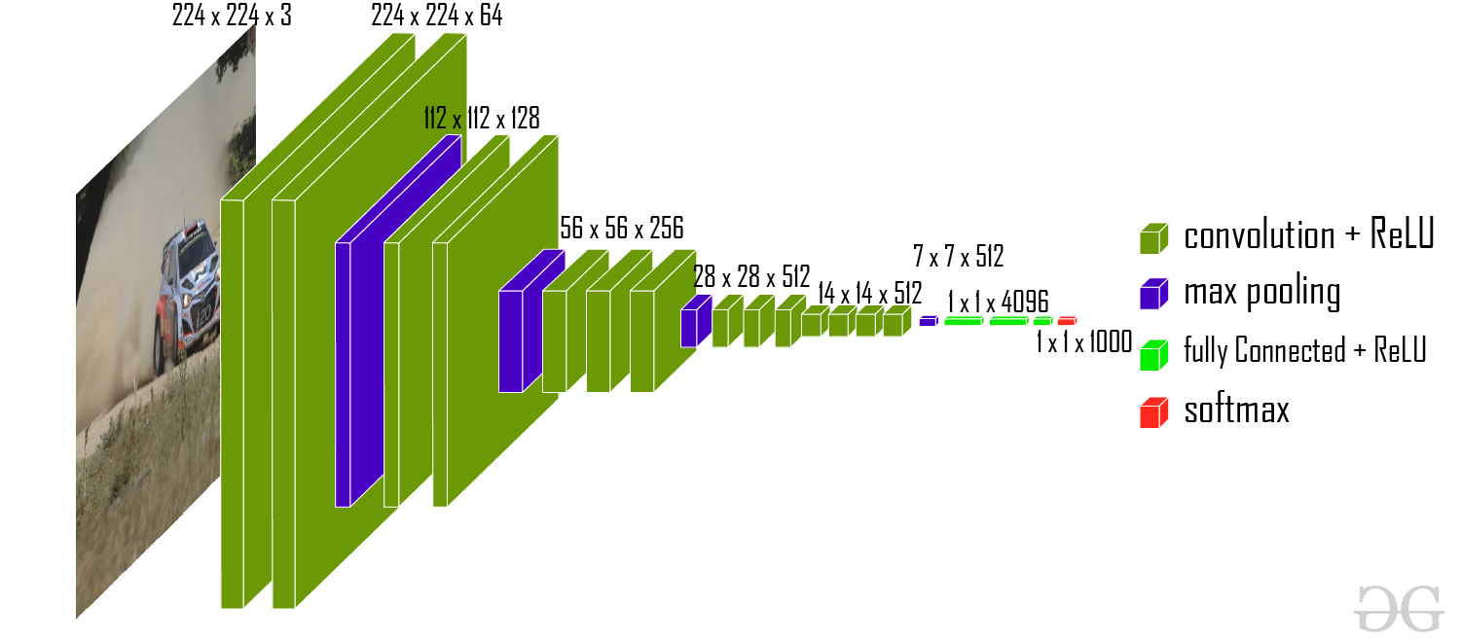
Model architecture

Slide 13
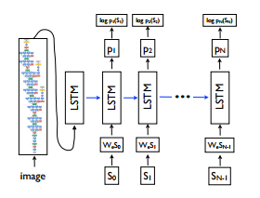
Architecture details:

Slide 14
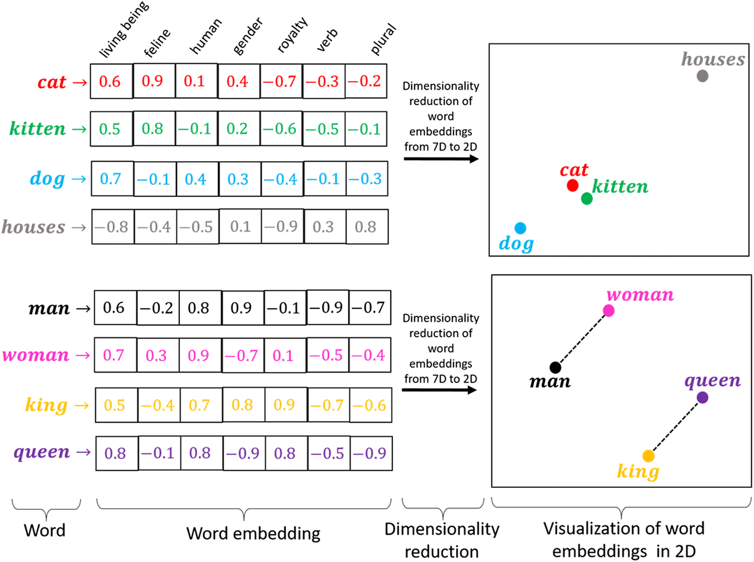
Word embeddings
To encode the words in form of vector using Gloves

Slide 15
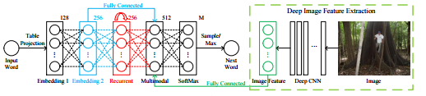
Full Model Details

Slide 16
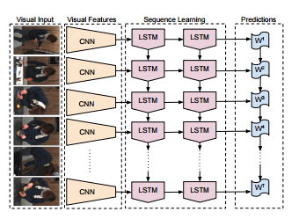
OUTPUT GENERATIONS

Slide 17
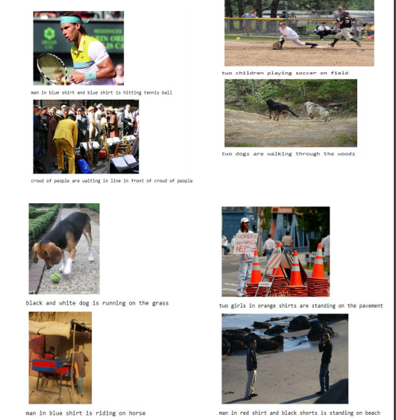
OUTPUT

Slide 18
THANK YOU

